Slide 1
PHPStorm license
Guide 01

Slide 2
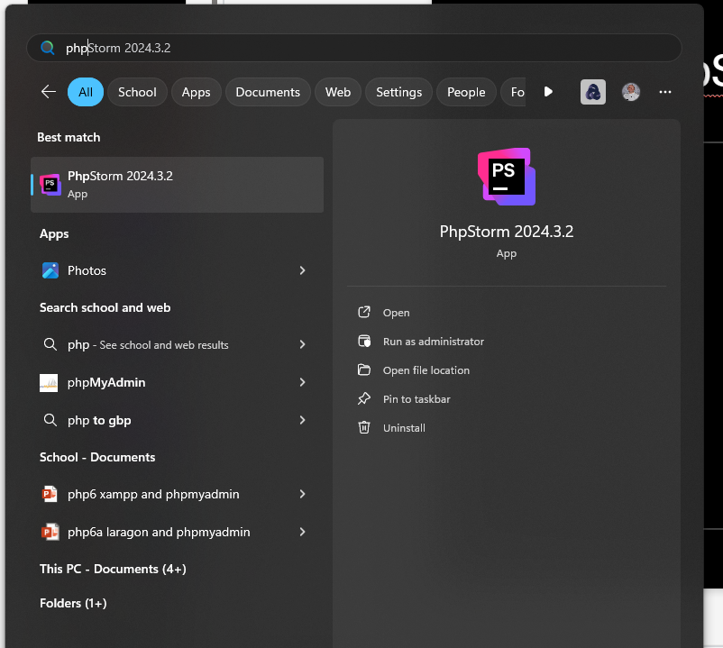
Open PhpStorm

Slide 3
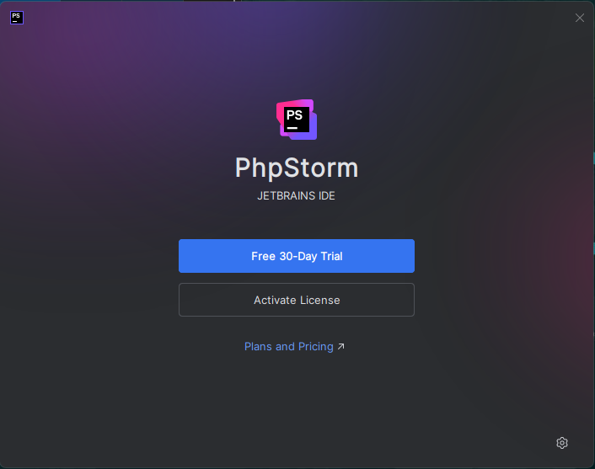
Choose Activate License
Click here:

Slide 4
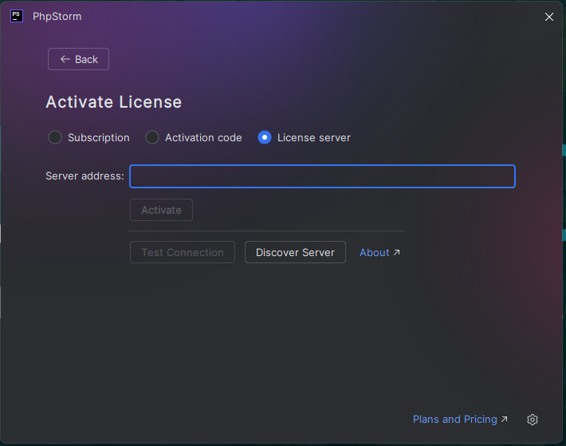
Choose License Server
Click here:

Slide 5
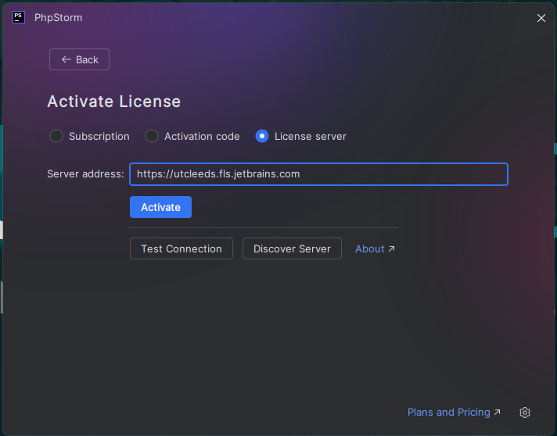
Enter this info
Enter this web address:
https://utcleeds.fls.jetbrains.com
Then click activate

Slide 6
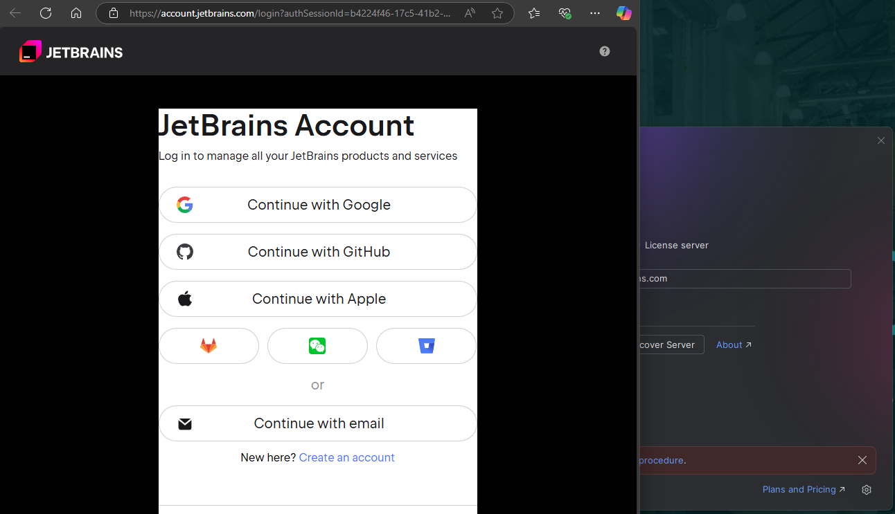
Web browser appears
Login with appropriate
account

Slide 7
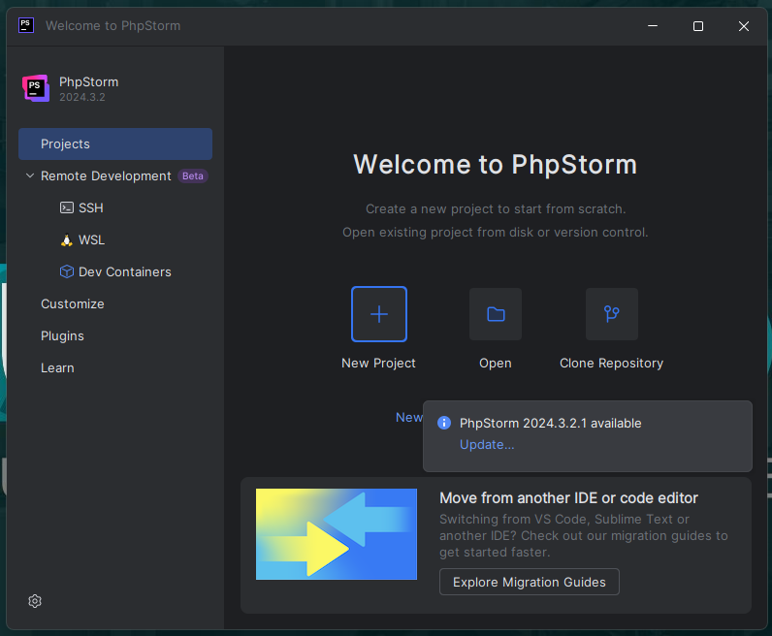
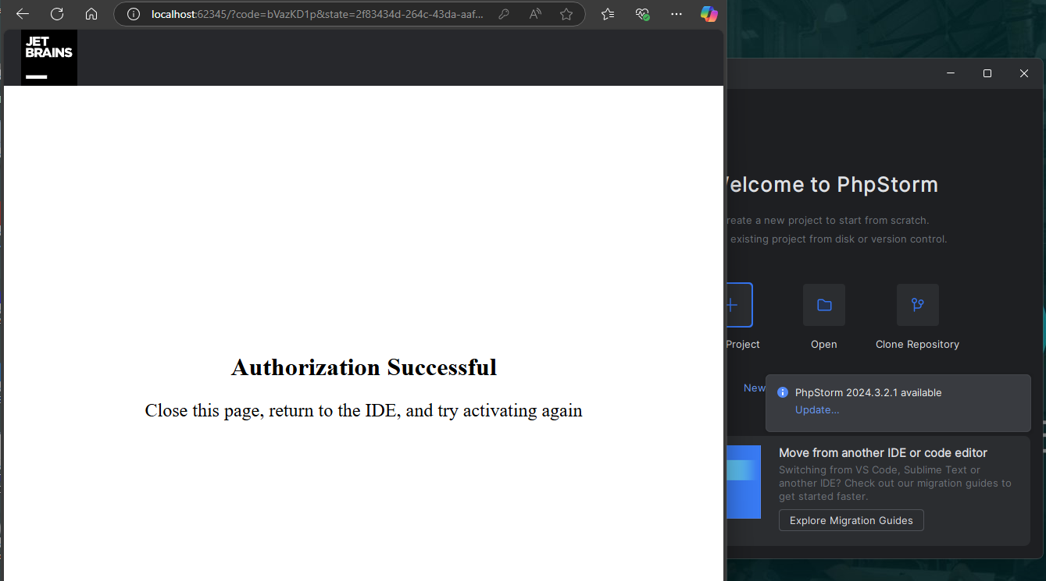
Successful, close the browser
Closed browser, ready to go.
Success

